Slide 1
Diverse Vision-Based Puzzle Solver
P556 Final Project (Group 8)
INDIANA UNIVERSITY

Slide 2
The Problem
SECTION 1

Slide 3
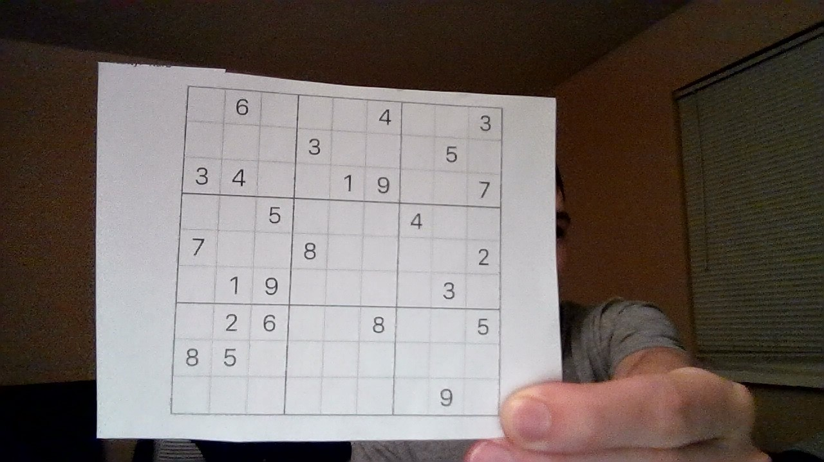
What is the solution to this puzzle?

Slide 4
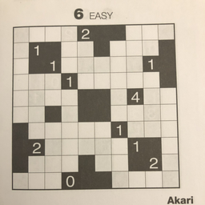
Or how about this one?

Slide 5
Prior Work
SECTION 2

Slide 6
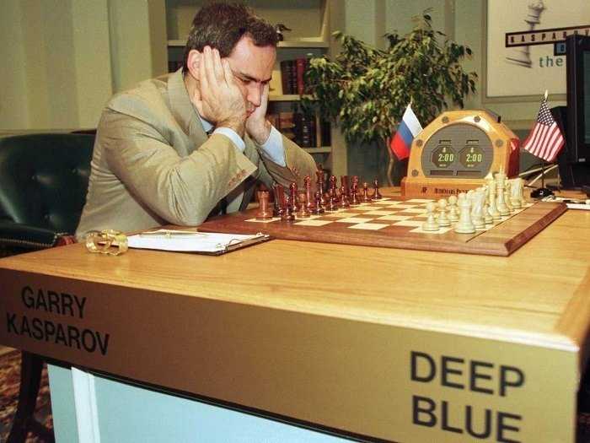
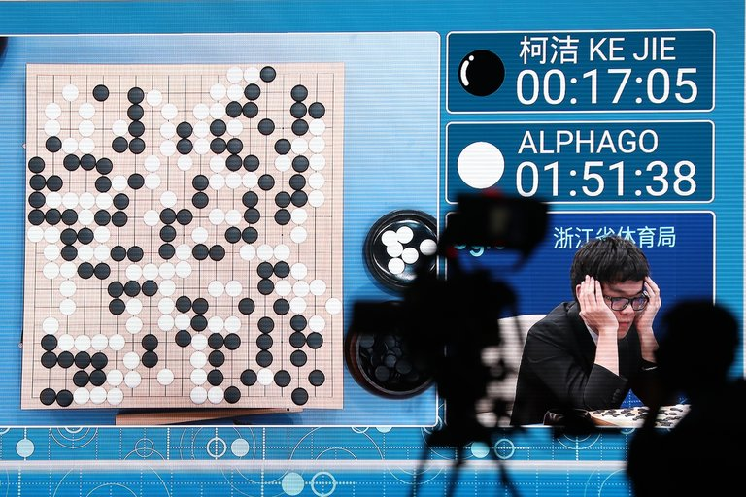
Prior Work – Puzzles & Vision
Touchstone of learning & intelligence
Puzzles & Games:
Deep Blue (IBM)
AlphaGo (Google)
Pedagogical Tools
CV Information Extraction
(see last slide for references)

Slide 7
Approach
SECTION 3

Slide 8
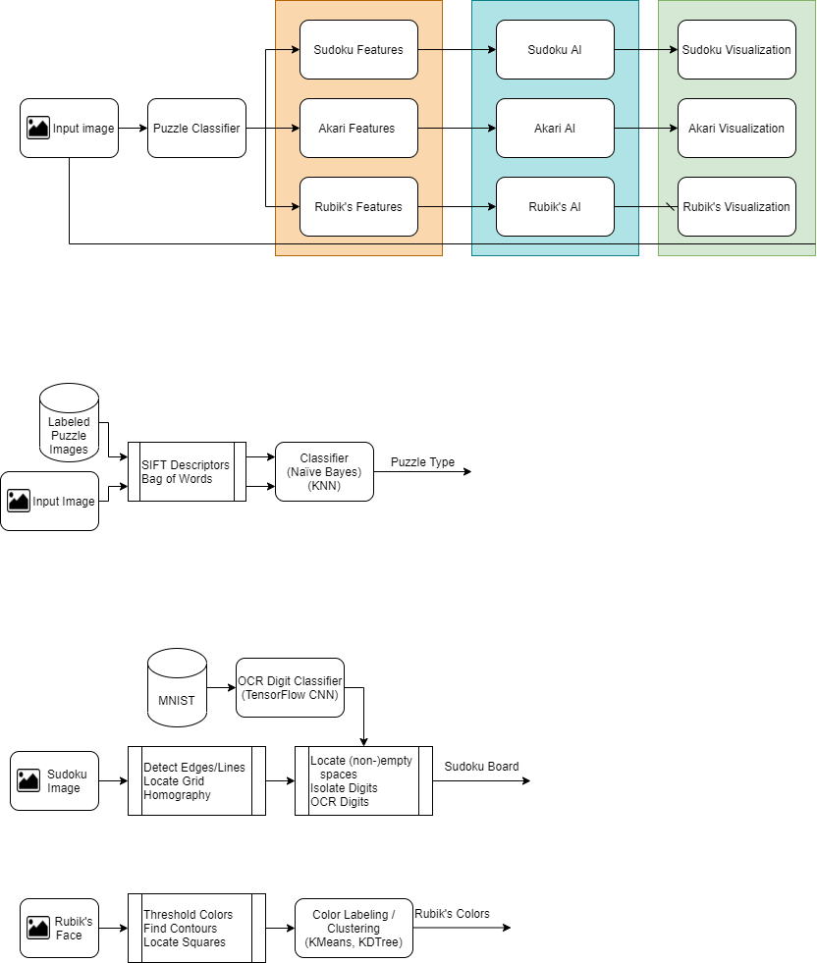
General Approach

Slide 9
Experiments & Implementation
SECTION 4

Slide 10

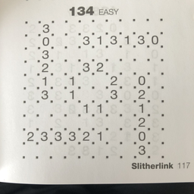
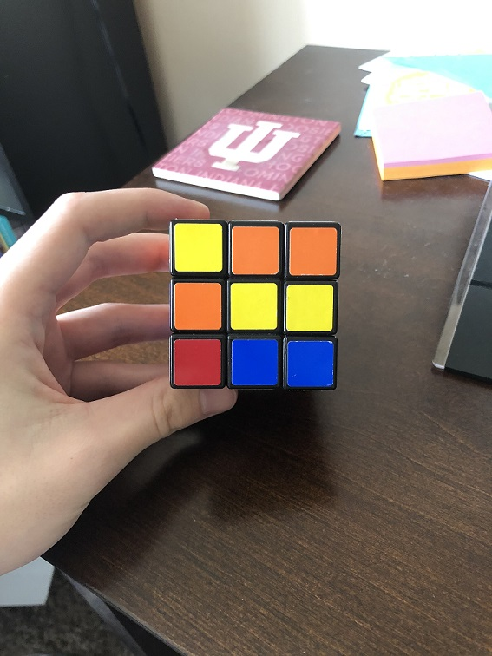
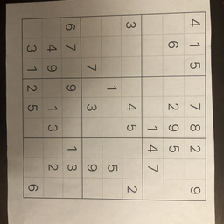
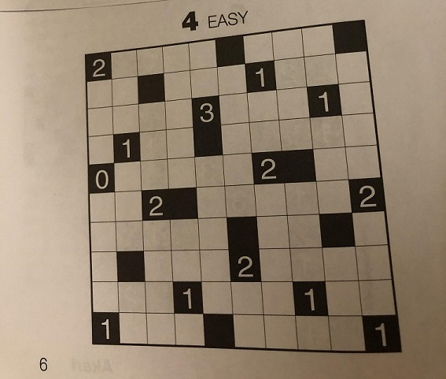
Input Images

Slide 11
Puzzle-type Classifier

Slide 12
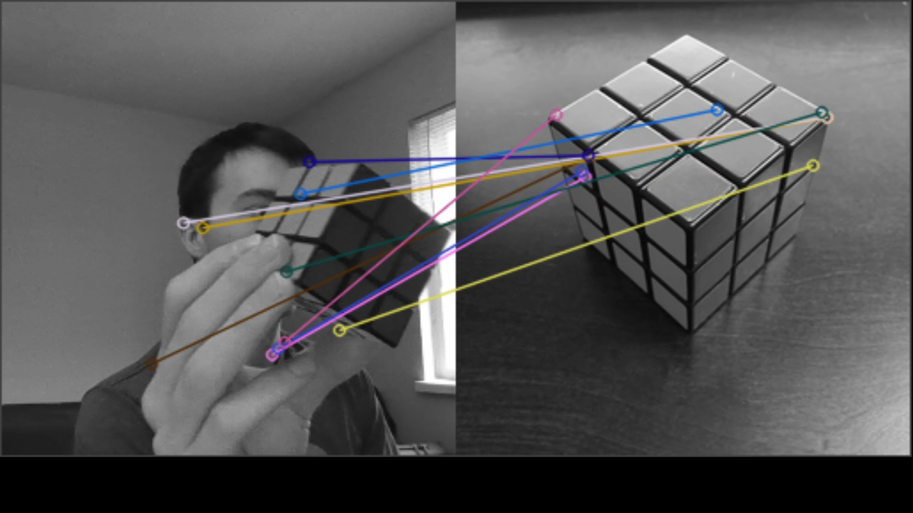
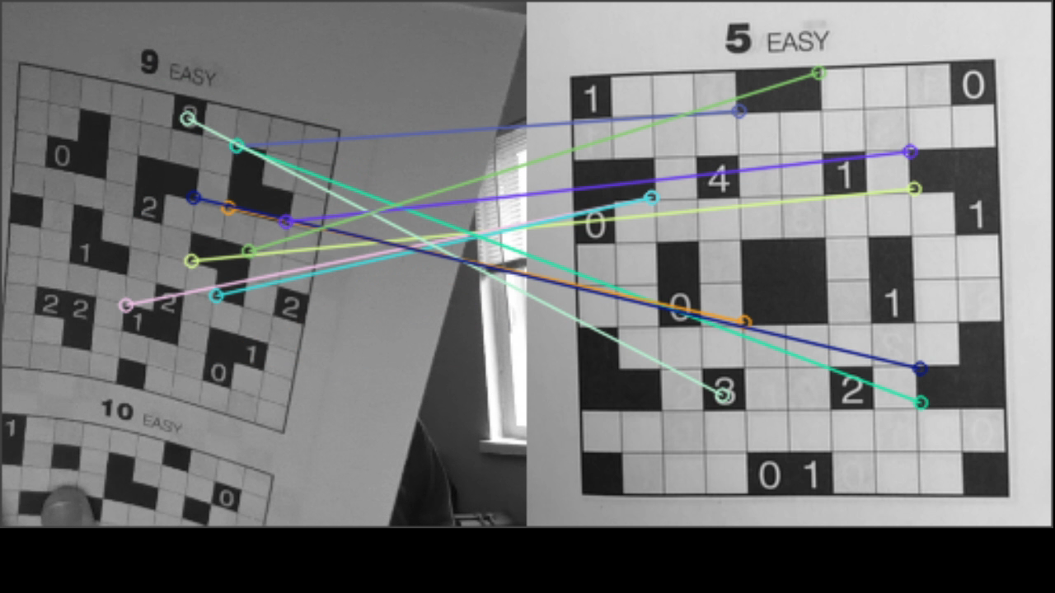
Puzzle-type Classifier Evaluation / Results
Very small dataset (~40 images)
Neural Networks not an option
Difficult to evaluate performance
Video, with multiple frames, demonstrates classifier accuracy

Slide 13
Sudoku Features

Slide 14
Sudoku Features

Slide 15
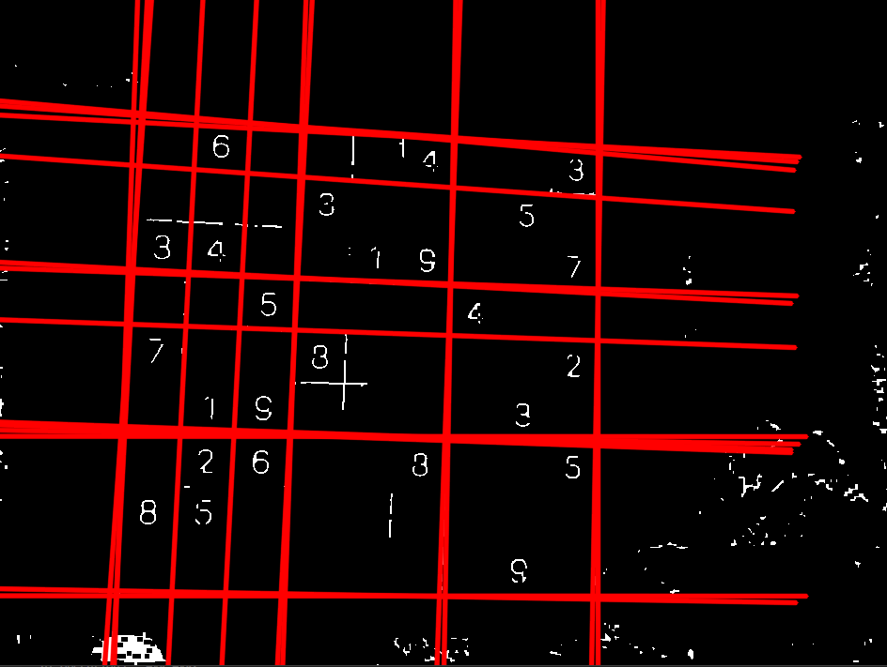
Sudoku Features

Slide 16
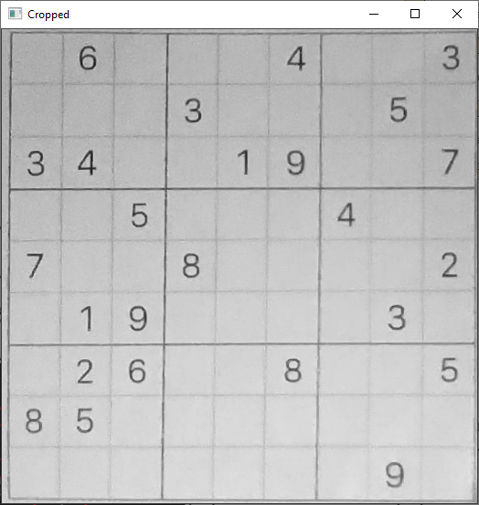
Sudoku Features

Slide 17



Sudoku Features

Slide 18
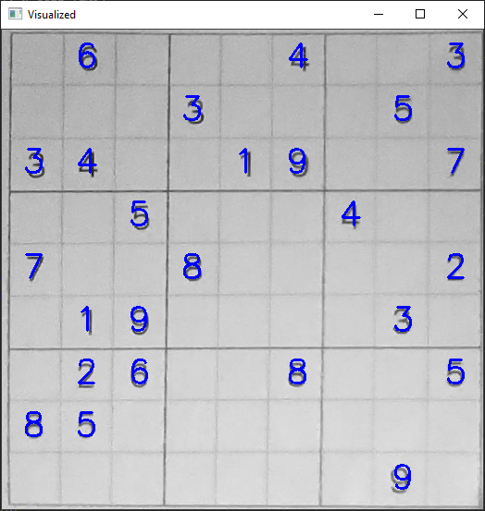
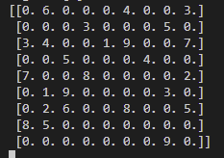
Sudoku Features

Slide 19
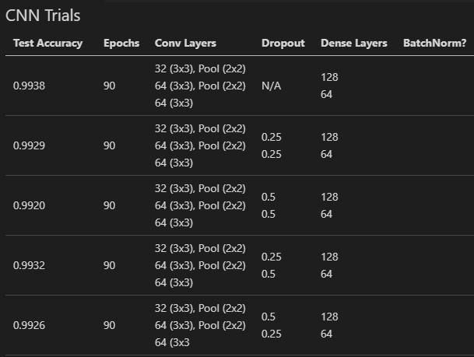
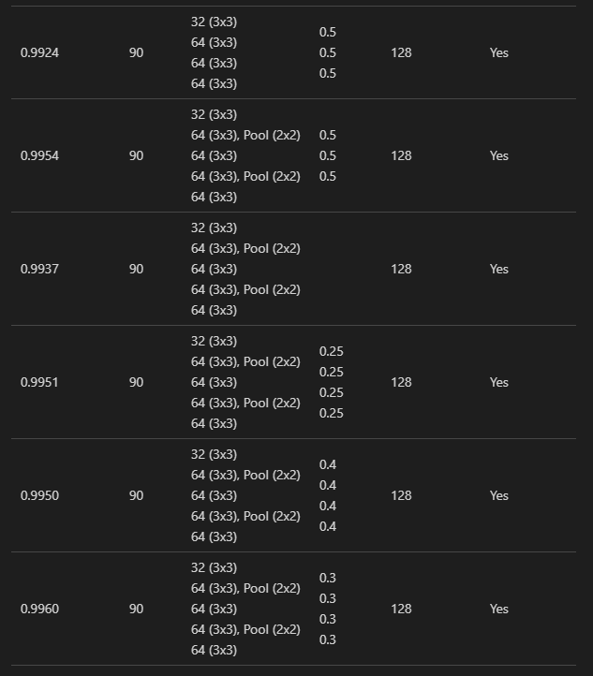
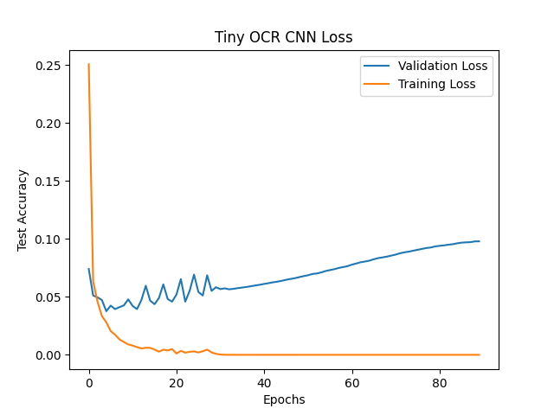
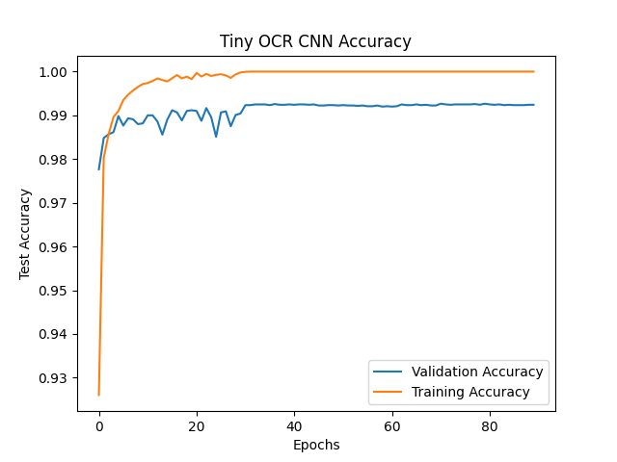
Sudoku Features Evaluation / Results
Robust puzzle identification and OCR extremely important
Handcrafted architecture development to optimize CNN

Slide 20
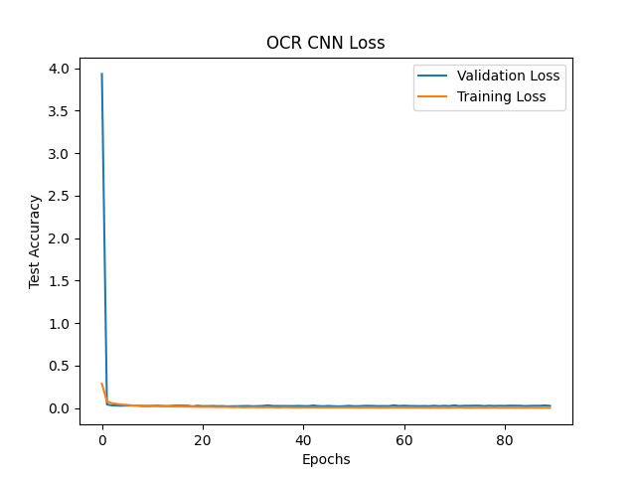
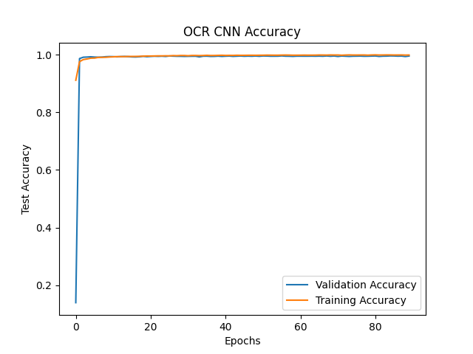
Sudoku Features Evaluation / Results
Robust puzzle identification and OCR extremely important
Handcrafted architecture development to optimize CNN

Slide 21
Final Results
SECTION 5

Slide 22
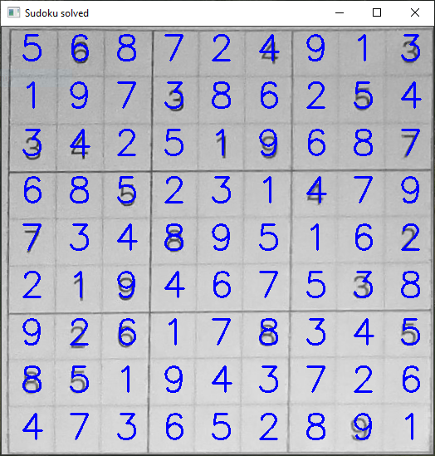
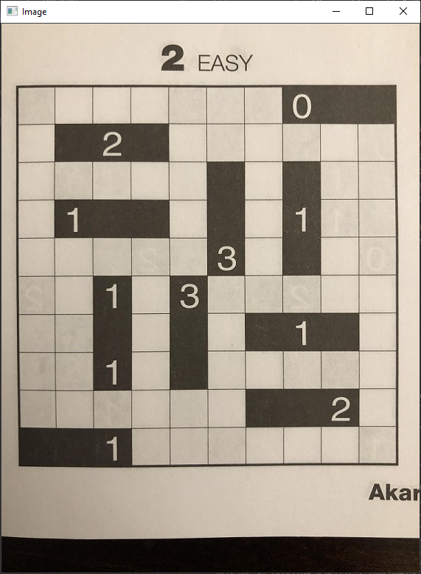
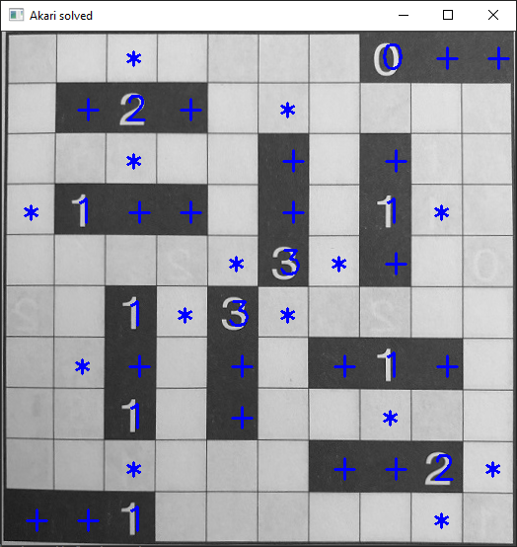

Slide 23
Discussion
SECTION 6

Slide 24
Discussion
Problem with pipeline model: a failure anywhere in the pipeline causes a failed solution...
Needs better CV: not very robust to lighting changes
(especially when identifying colors in Rubik’s cube)
In progress: CNN for Sudoku solution. Using iterative process (like game neural networks).

Slide 25
Questions?
Feel free to ask questions in the zoom chat.
Thanks!

Slide 26
References:
Papers:
Feng-hsiung Hsu. IBM’s deep blue chess grandmaster chips.IEEE Micro, 1999
Fei-Yue Wang, et al. Where does alphago go: From church-turing thesis to alphago thesisand beyond.IEEE/CAA Journal of Automatica Sinica, 3(2):113–120, 2016
Z. Markov, I. Russell, T. Neller, and N. Zlatareva. Pedagogical possibilities for the n-puzzleproblem. InProceedings. Frontiers in Education. 36th Annual Conference, 2006
S. Gur and O. Ben-Shahar. From square pieces to brick walls: The next challenge in solvingjigsaw puzzles. In2017 IEEE International Conference on Computer Vision (ICCV), 2017.
Lowe, D.G. Distinctive Image Features from Scale-Invariant Keypoints. International Journal of Computer Vision 60, 91–110 (2004)
Images:
https://static01.nyt.com/images/2017/05/24/technology/24bitsdaily-web/24bitsdaily-web-master768.jpg
https://allthatsinteresting.com/wordpress/wp-content/uploads/2015/11/deep-blue-chess-match.jpg

